Slide 1
CRIMINAL Tracking SYSTEM

Slide 2
ABSTRACT
Criminal tracking System is a system used to report crimes. This project is mainly useful for police Departments. This system will help to manage all the activities in a police Department using computers. Currently all the works are done manually, . There is no system of data storage, data sharing and accessing data. There is no system under which one police Department can talk to another directly.

Slide 3
OBJECTIVE
by computerizing all the activities inside a police Department can be managed easily and effectively. The police Departments in the country are, today, virtually unconnected islands. Thanks to telephones and wireless, and especially thanks to mobile telephones, there is voice connectivity between the police Department and senior police officers,

Slide 4
HARDWARE SPECFICATION
Processor : P 4 700 GHz.
RAM : 4 GB RAM
Hard Disk Drive : 180 GB

Slide 5
SOFTWARE SPECIFICATION
Operating System : Windows 7/8/10
Front End : JAVA
Back End : ORACLE

Slide 6
EXISTING SYSTEM
This system is very hard to find criminals which may cause some issues. It can’t be searching the criminal list if we want to search the particular criminal very difficult to tracking. Criminals details are stored as document wise so we can’t search the criminals.
DRAWBACKS:
The existing system has the following drawbacks.
There is not possible to find one particular criminal detail.
Lot of paper to be wasted
It takes too much time to register the criminal details

Slide 7
PROPOSED SYSTEM
In this criminal finder system easily find the person has any case or not. Using an author id based we can find the criminal details which could be easy to find the criminal details. Any time anywhere we can see about the criminal detail, we no need to take the file anywhere.
FEATURES:
Easy to find criminal
Fully systematic process
No one will be escaped

Slide 8
Modules
Criminal Registration
Criminals data has register in this module which can maintain the criminals report. We can’t identify the criminal’s details before registration
Police Registration
This module contains collect all the information about the police, this module collects username and password as well, based on this we can able to login to this application.

Slide 9
Allocate case
In this will be allocate the criminal case which could be easily identify the case wise criminal reports.
Search Criminals
Search criminal’s module will help to identify the criminal by its author number. This is a main module in this project. Which may be avoid unwanted issues.
Criminal History
This module will be showing an history of criminal’s record. Which is used to find the past criminal case.

Slide 10

Data Flow Diagram
Level 0

Slide 11
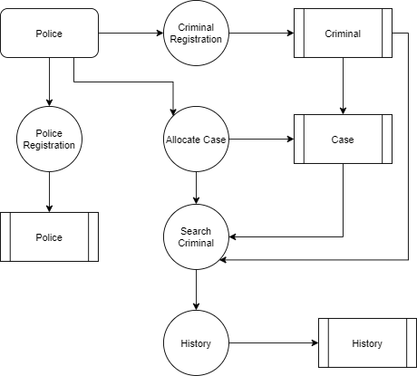
Level 1:

Slide 16
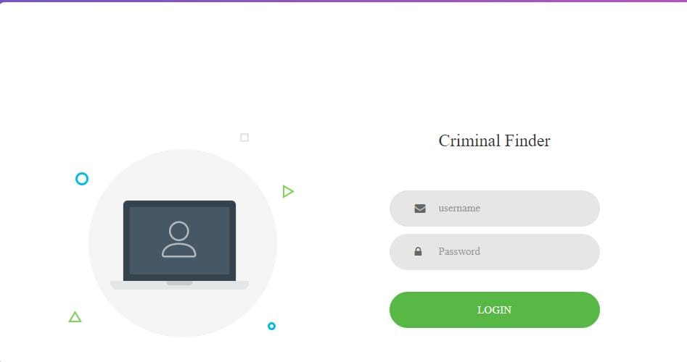

Slide 17
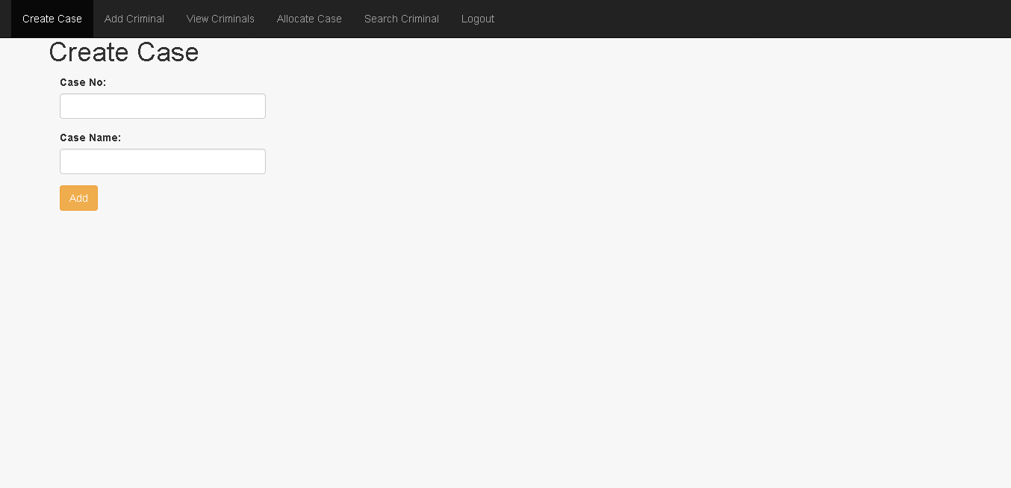

Slide 18
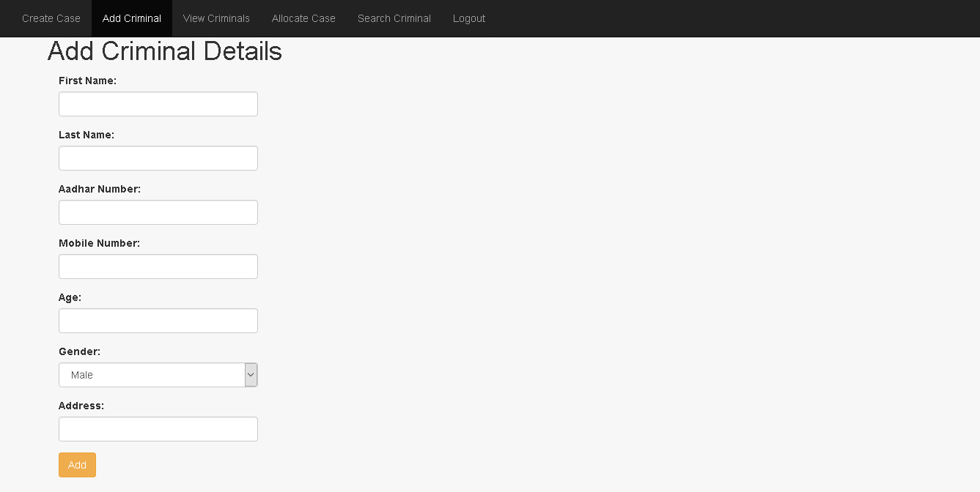

Slide 19
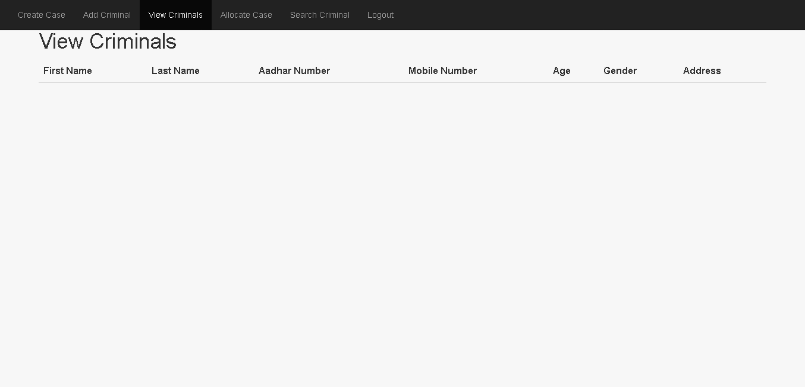

Slide 20
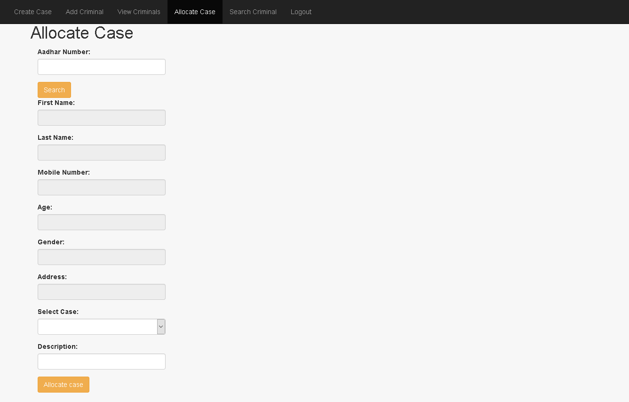

Slide 21
Thank You

